Slide 1
Topic (Custom): Sign Language-to-Text(Real-Time Recognition)
Group Members:
Kashan Sardar, 70284, kashan.sardar@tu-ilmenau.de
Tabish Khan, 70396, tabish.khan@tu-ilmenau.de
Dated: 15 August 2025

Slide 2
Introduction & Motivation
Sign language is the primary communication mode for the hearing-impaired.
Traditional recognition systems focus only on static gestures or require expensive sensors.
Need for real-time, camera-based solution that supports both static and motion gestures.
Goal: Groundwork for a two-way Real-Time Sign Language Translating System using XR Technologies

Slide 3
Project Objectives
Gesture Recognition:
Static ASL letters: A, B, L, V, Y.
Dynamic motion gesture: HELLO (open palm, left-to-right).
Accuracy & Speed:
90% accuracy in real-time testing.
Smooth frame rate (>20 FPS).
User-Friendly UI:
Clear ROI, confidence bar, sentence builder, and projector-friendly text.
Modularity:
Easily extendable for more gestures in the future.

Slide 4
Project Description
This project is a real-time sign language recognition system that detects both static and dynamic gestures. Five static ASL letters (A, B, L, V, Y) are classified using a custom CNN, while the HELLO gesture is recognized through palm-open motion tracking. The system runs on standard hardware and features a clear UI with sentence building and optional text-to-speech.

Slide 5
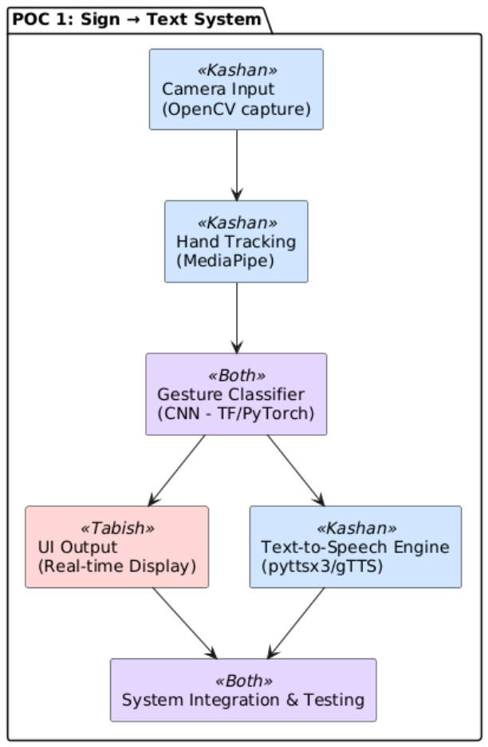




Distribution of Work & Technologies Used

Slide 6
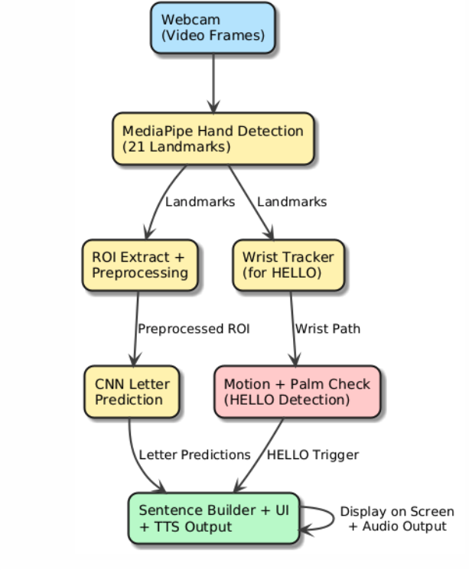
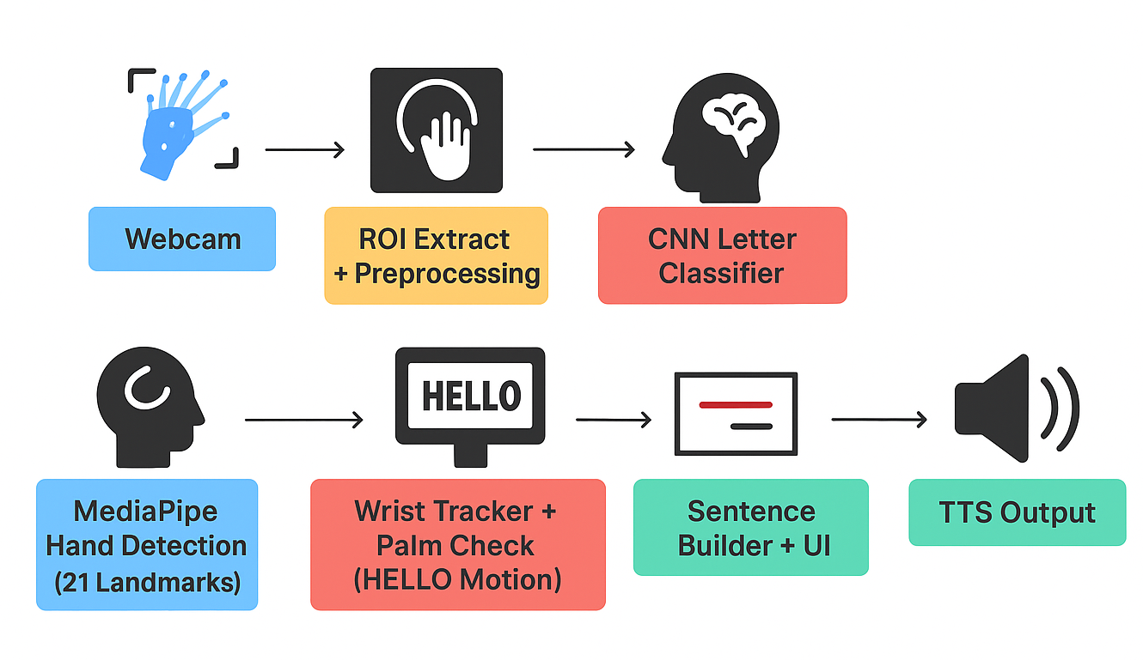
System Architecture

Slide 7
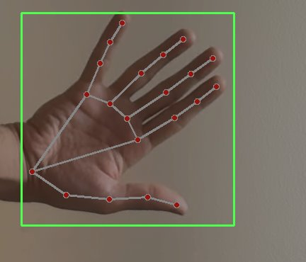
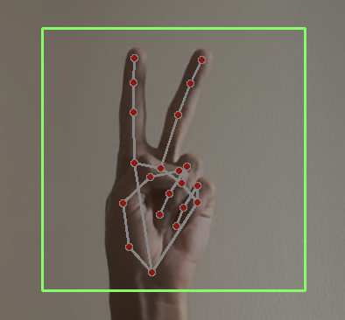
Methodology Overview
Dataset Creation:
Custom images for A, B, L, V, Y.
HELLO handled via motion tracking (no CNN training).
ROI size: 300×300 px → converted to 28×28 grayscale for CNN.
Model Training:
CNN architecture: 2 convolution layers, 2 pooling layers, 2 dropout layers.
Validation accuracy: 94%.
Gesture Processing:
MediaPipe for hand landmarks.
Stability filter (1s hold) for static gestures.
Motion + palm check for HELLO.
UI & Output:
High-contrast ROI, sentence builder, and optional text-to-speech.

Slide 8
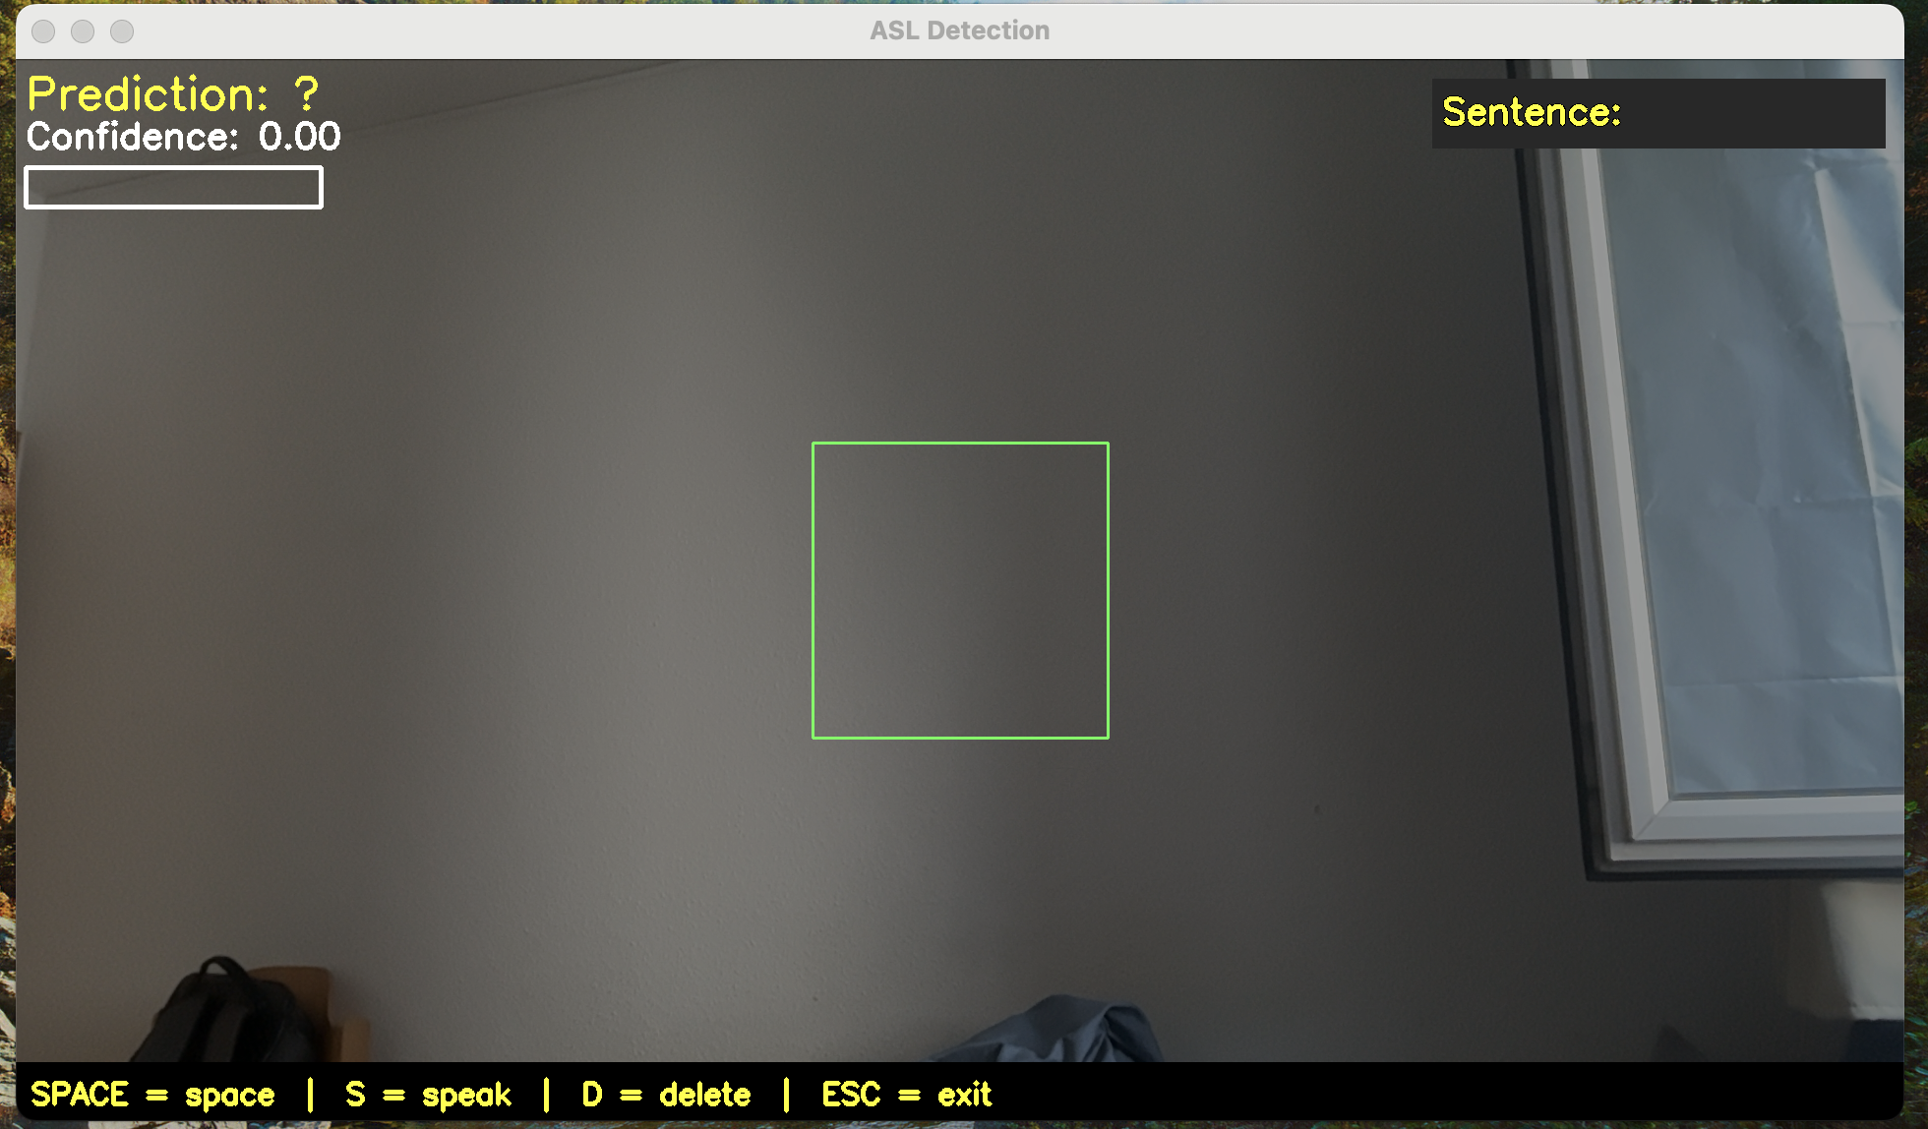
User Interface
ROI Box: Guides correct hand placement.
Confidence Bar: Shows live prediction certainty.
Sentence Builder: Displays recognized letters & words.
Keyboard Controls:
Space → Add space.
S → Speak sentence.
D → Delete last letter.
ESC → Exit.

Slide 9
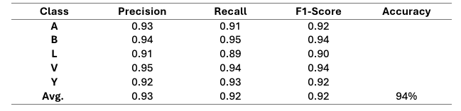
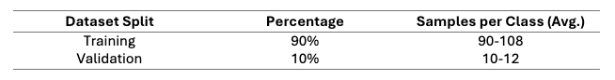
Results & Performance
Static Letters:
Validation accuracy: 94%
Real-time accuracy: ~90%
Dynamic Gesture:
HELLO detection rate: ~95% (controlled conditions)
Performance:
Average FPS: 25–30

Slide 10
Challenges & Solutions
Challenge | Solution
False positive during the letter switching | Stability Filter + Cooldown
HELLO Confusion with other gesture | Palm-open check + strict motion boundary
Lightening/Background Issues | Controlled capture environment + clear ROI
Motion blur in HELLO Detection | 1-second max motion window

Slide 11
Conclusion & Future Work
Achievements:
Successfully recognized 5 ASL letters + HELLO motion gesture in real time.
Smooth performance with simple hardware (MacBook Pro webcam).
Future Enhancements:
Expand dataset to cover full ASL alphabet & common words.
Add more dynamic gestures (YES, NO, THANK YOU).
Train for robustness in uncontrolled environments.
Integrate into AR/VR platforms for immersive experiences.

Slide 12
References
F. Lugaresi et al., “MediaPipe: A framework for building perception pipelines,” arXiv:1906.08172, 2019.
N. Kaggle, “Sign Language MNIST Dataset,” [Online]. Available: https://www.kaggle.com/datamunge/sign-language-mnist
M. Abadi et al., “TensorFlow: Large-scale machine learning on heterogeneous systems,” 2015. [Online]. Available: https://www.tensorflow.org/
G. Bradski, “The OpenCV Library,” Dr. Dobb’s Journal of Software Tools, 2000.
F. Chollet, “Keras: Deep Learning for humans,” [Online]. Available: https://keras.io/

Slide 13

Thank You For Your Attention!
This Photo by Unknown Author is licensed under CC BY-SA

